Slide 1
Quiz 3 - PrequizReview Chapters 9 – 10

Slide 2
Chapters 9 - 10
9. Sinusoidal Steady State Analysis
10. Sinusoidal Steady-State Power Calculations

Slide 3
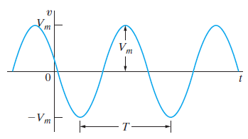
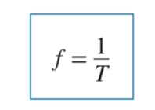

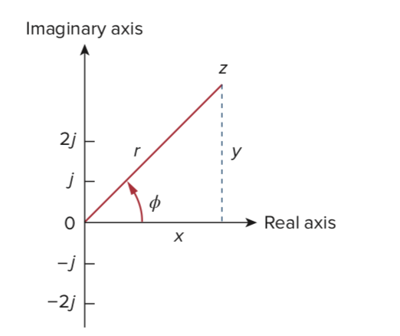
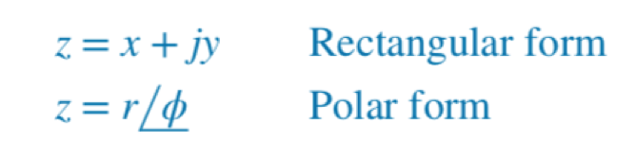

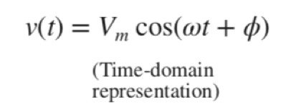

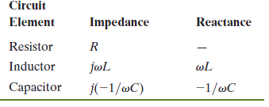

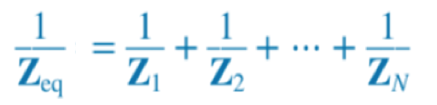
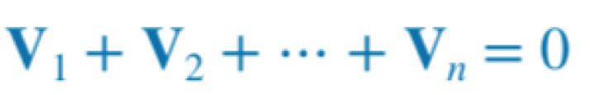

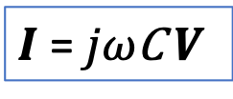

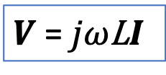

Chapter 9 – Sinusoidal Steady-State Analysis
Main ideas:
The Sinusoidal Source
Complex Numbers
The Phasor
Passive Circuit Elements
in the Frequency Domain
KVL & KCL, Series-Parallel Equivalents
$v$= ${ V}_{m}$ Cos($ωt+φ$)
Complex number arithmetic
V = x + jy
$V$ = ${ RI}_{ }$
$V$ = ${jω\text{L}I}_{ }$
$I$ = ${jω\text{C} V}_{ }$

Slide 4
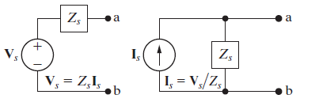
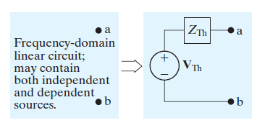
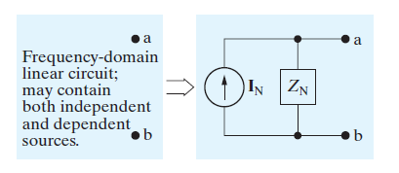
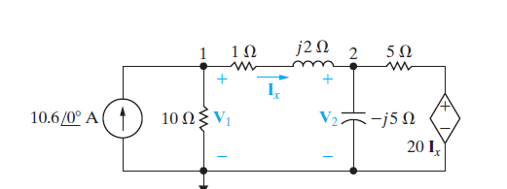
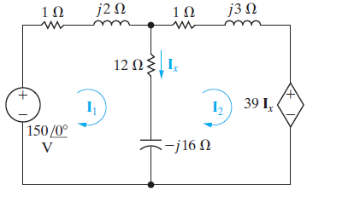
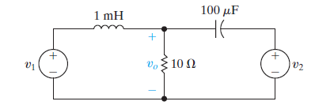
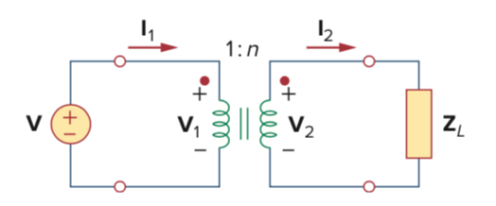
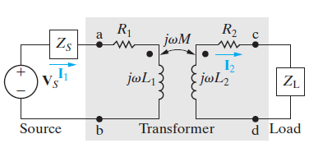
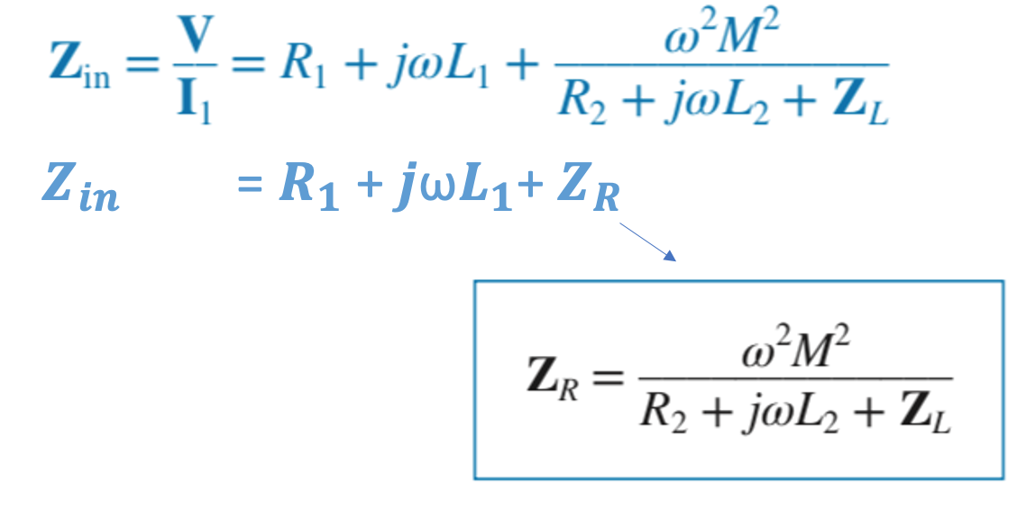
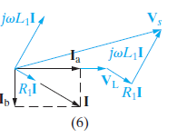
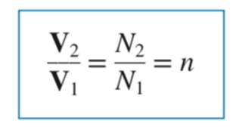

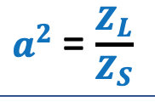
Chapter 9 – Sinusoidal Steady-State Analysis
Main ideas:
Source Transformations,
Thevenin & Norton Equivalents
Node Voltage & Mesh Current Methods
Superposition
The Transformer (Linear & Ideal)
Phasor Diagrams
Sources with different ω
Max
power

Slide 5
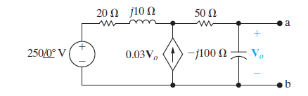
Problem: Thevenin’s Equivalent
Problem 9.50
Find the Thevenin equivalent circuit with
respect to terminals a, b.

Slide 6
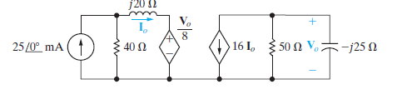
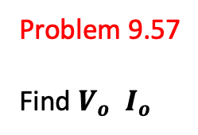
Problem: Node Voltage Method
Problem 9.57
Find $V_{o}$ $I_{o}$

Slide 7
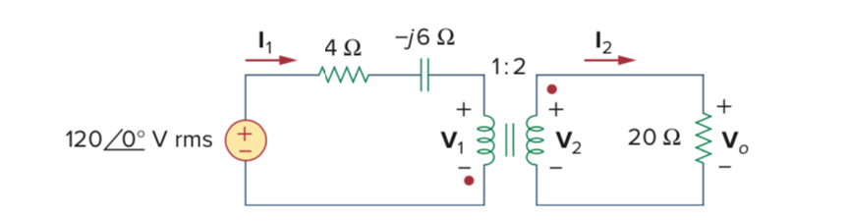
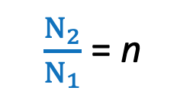
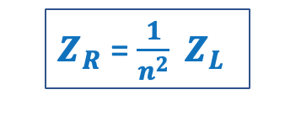
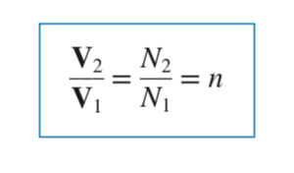
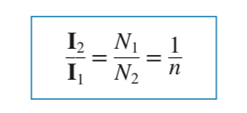

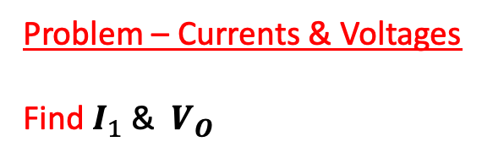
9.11 The Transformer, Ideal Transformer
Problem – Currents & Voltages
Find $I_{1}$ & $V_{O}$
$N_{1}$: $N_{2}$

Slide 8
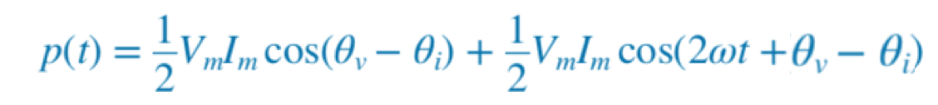
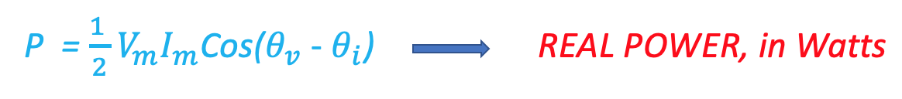


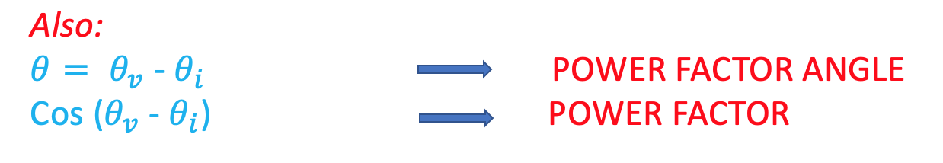
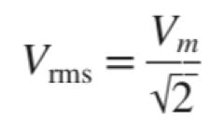
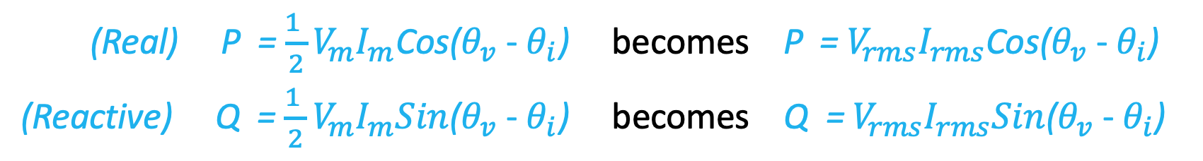
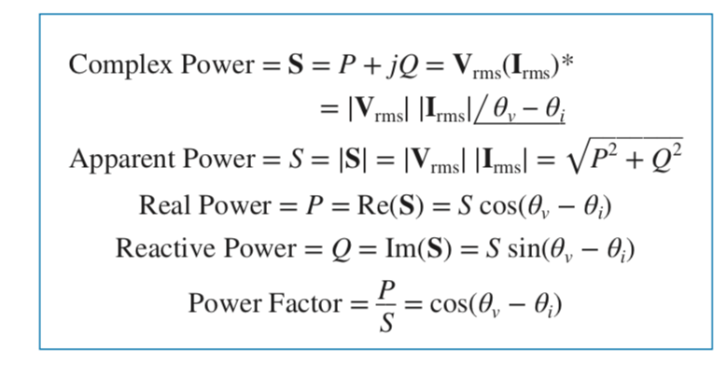
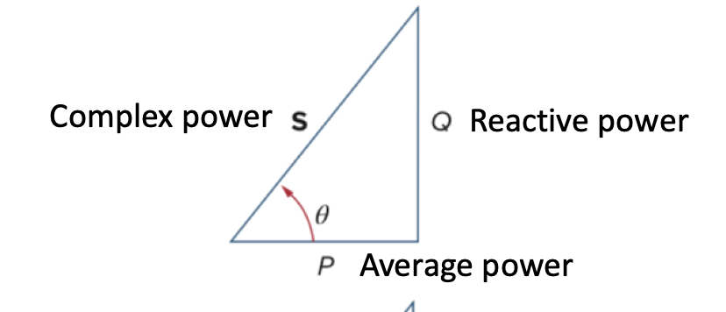
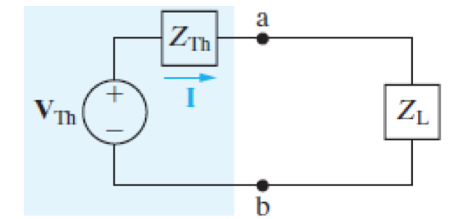
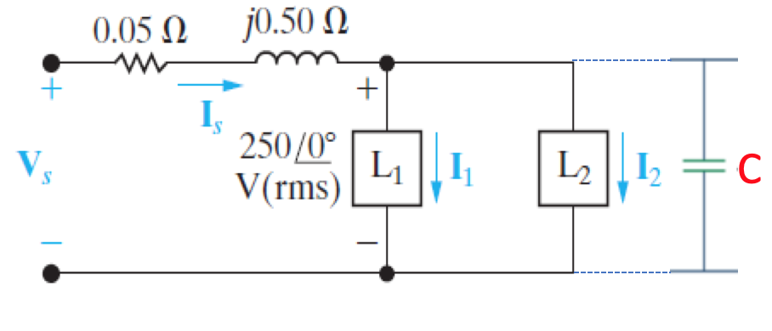
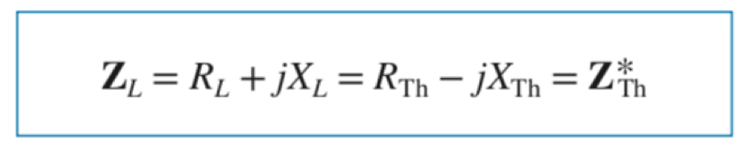
Chapter 10 – Sinusoidal Steady-State Power
Main ideas:
Instantaneous Power
Average (or Real) and Reactive Power
Rms Value and Power Calculations
Complex Power
Power factor correction, Max Power Transfer

Slide 9
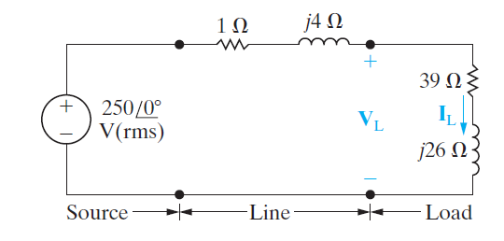



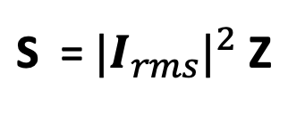
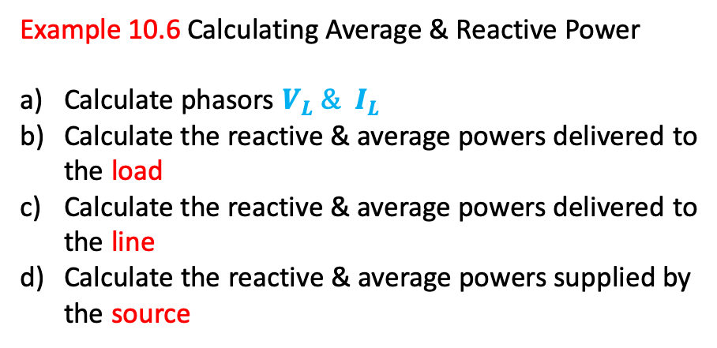
10.5 Power Calculations
Example 10.6 Calculating Average & Reactive Power
Calculate phasors $V_{L} \& I_{L}$
Calculate the reactive & average powers delivered to the load
Calculate the reactive & average powers delivered to the line
Calculate the reactive & average powers supplied by the source

Slide 10
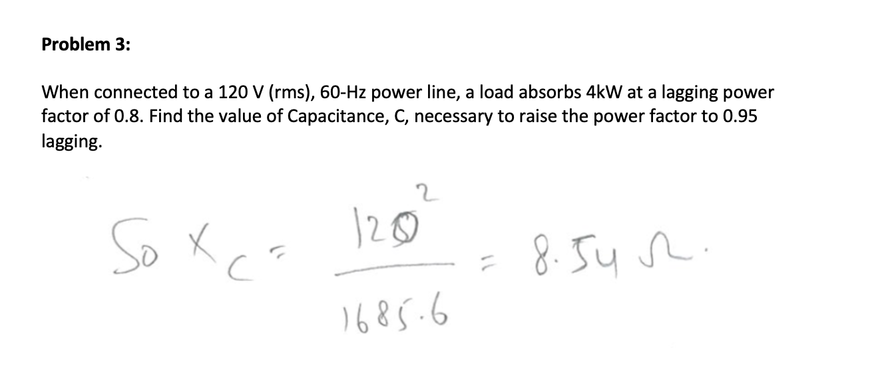
10.5 Power Calculations HW problem 3

Slide 11
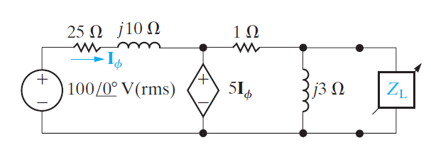
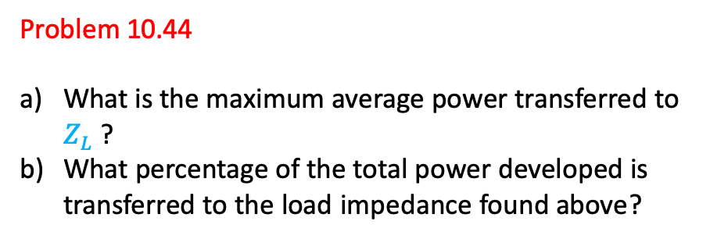
Maximum Power Transfer
Problem 10.44
What is the maximum average power transferred to $Z_{L}$ ?
What percentage of the total power developed is transferred to the load impedance found above?

